Slide 1



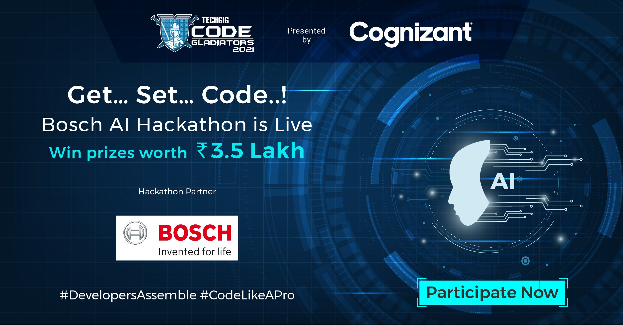

Slide 2
TEAM JARVIS
Team Leader Name: Vikash Kumar
Team Member Name: Nil
Team Leader Phone Number: 8210802960
Team Leader Email ID: wiryvikash15@gmail.com

Slide 3

Model Description
As per the requirement of the Bosch AI Hackathon, The AI model developed is designed to be capable of negotiating obstacles, cleaning robots Point Of View (POV), that includes following objects.
  Furniture (especially Legs/pols).
    Example: chair, Tables, Sofa
  Doors
  cables/ wires lying around
  socks/ small garments

Slide 4
Features of the Model
The model uses bounding box labeling.
A testing image can contain either one of the object from above classes or multiple of them.
The model can identify and give the desired output, in terms of speed and performance.
The model has higher efficiency and reliability for industrial applications.

Slide 5
Tech Stack
The model has used the bounding box labeling using the labelImg module.
The building of the module is done using the python language ,Tensorflow, Keras, command prompt, LabelImg, Google Colab, Jypter Notebook, Google Drive, Github

Slide 6
Why your model is the best?
The model is designed to meet the expectation of the end user, in terms of speed and performance.
It identifies the images in a split of seconds and gives the very good output with the efficiency of >90%.
The model is trained with the output of very less packet loss and trained the model upto Step 37500 per-step time 0.132 loss=0.114.
The robot is reliable and meets the industrial requirements.

Slide 7
Labelled Images used for Training Model
The labelled images used for training the model can be accesed :
@ https://github.com/Vikash-Kumar-984/BOASH-AI-Hackhathon-TechGig-/tree/main/train
*The csv file for the trained model can be accessed :
@https://github.com/Vikash-Kumar-984/BOASH-AI-Hackhathon-TechGig-/blob/main/data/train_labels.csv

Slide 8
Images used in the Testing Model
The labelled images used for testing the model can be accessed :
@https://github.com/VikashKumar984/BOASHAIHackhathonTechGig-/tree/main/test
The csv file for the testing modle can be accessed :
@https://github.com/Vikash-Kumar-984/BOASH-AI-Hackhathon-TechGig-/blob/main/data/test_labels.csv

Slide 9
Working Model
The full working model with referenced codes can accessed at my Github page :)
@https://github.com/Vikash-Kumar-984/BOASH-AI-Hackhathon-TechGig-

Slide 10


